Slide 1


TIVIT

Slide 2
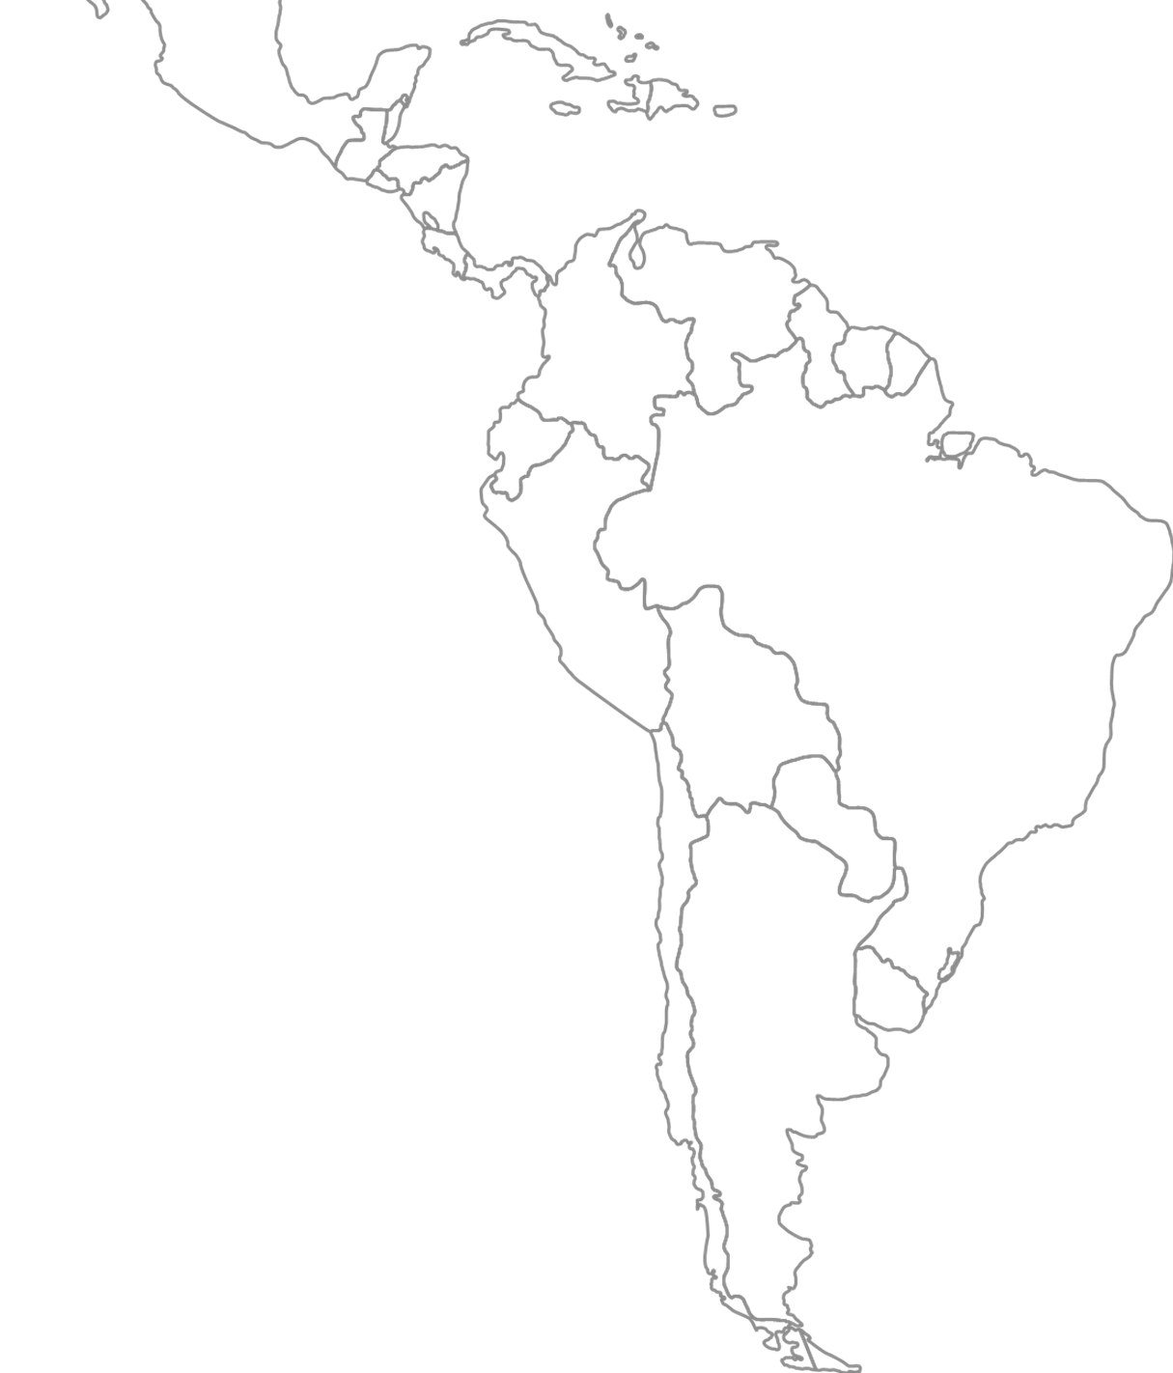










CONECTANDO TECNOLOGIA PARA UM MUNDO MEJOR
+25
Unidades
en América Latina
+6,2K
Colaboradores
Brasil y Latam
+3.5K
Nuevas certificaciones
en 2024
+87
Net Promoter Score 2024
vs +78 NPS 2023
Brasil
Paraguay
Argentina
Chile
Bolívia
Equador
Colômbia
Panamá
México
Peru
+6
Startups invertidas em los últimos 5 años
+20
Premios de tecnología e innovación em 2023 y 24

Slide 3

Hemos crecido, evolucionado, fortalecido nuestra presencia, somos más fuertes como empresa global y estamos listos para los desafíos del presente y del futuro!
2014
2021
2004
TIVIT se consolida en Latinoamérica y comienza a operar en 10 países.
Nuevas unidades de Soluciones Cyber y Financieras a través de TIVIT Labs
Se crea la marca TIVIT.
2025
Inauguración del SOC integrado más grande de América Latina
TIVIT y Almaviva se fusionan y forman una de las mayores empresas de servicios de LATAM
2010
2016 - 2017
2023
Apax, el mayor fondo global, invierte en TIVIT en América Latina.
Lanzamiento de TIVIT Private Cloud y spin-off de NeoBPO (BPO Services)
Takoda Spin-off (Data Centers) para permitir el enfoque en soluciones digitales

Slide 4

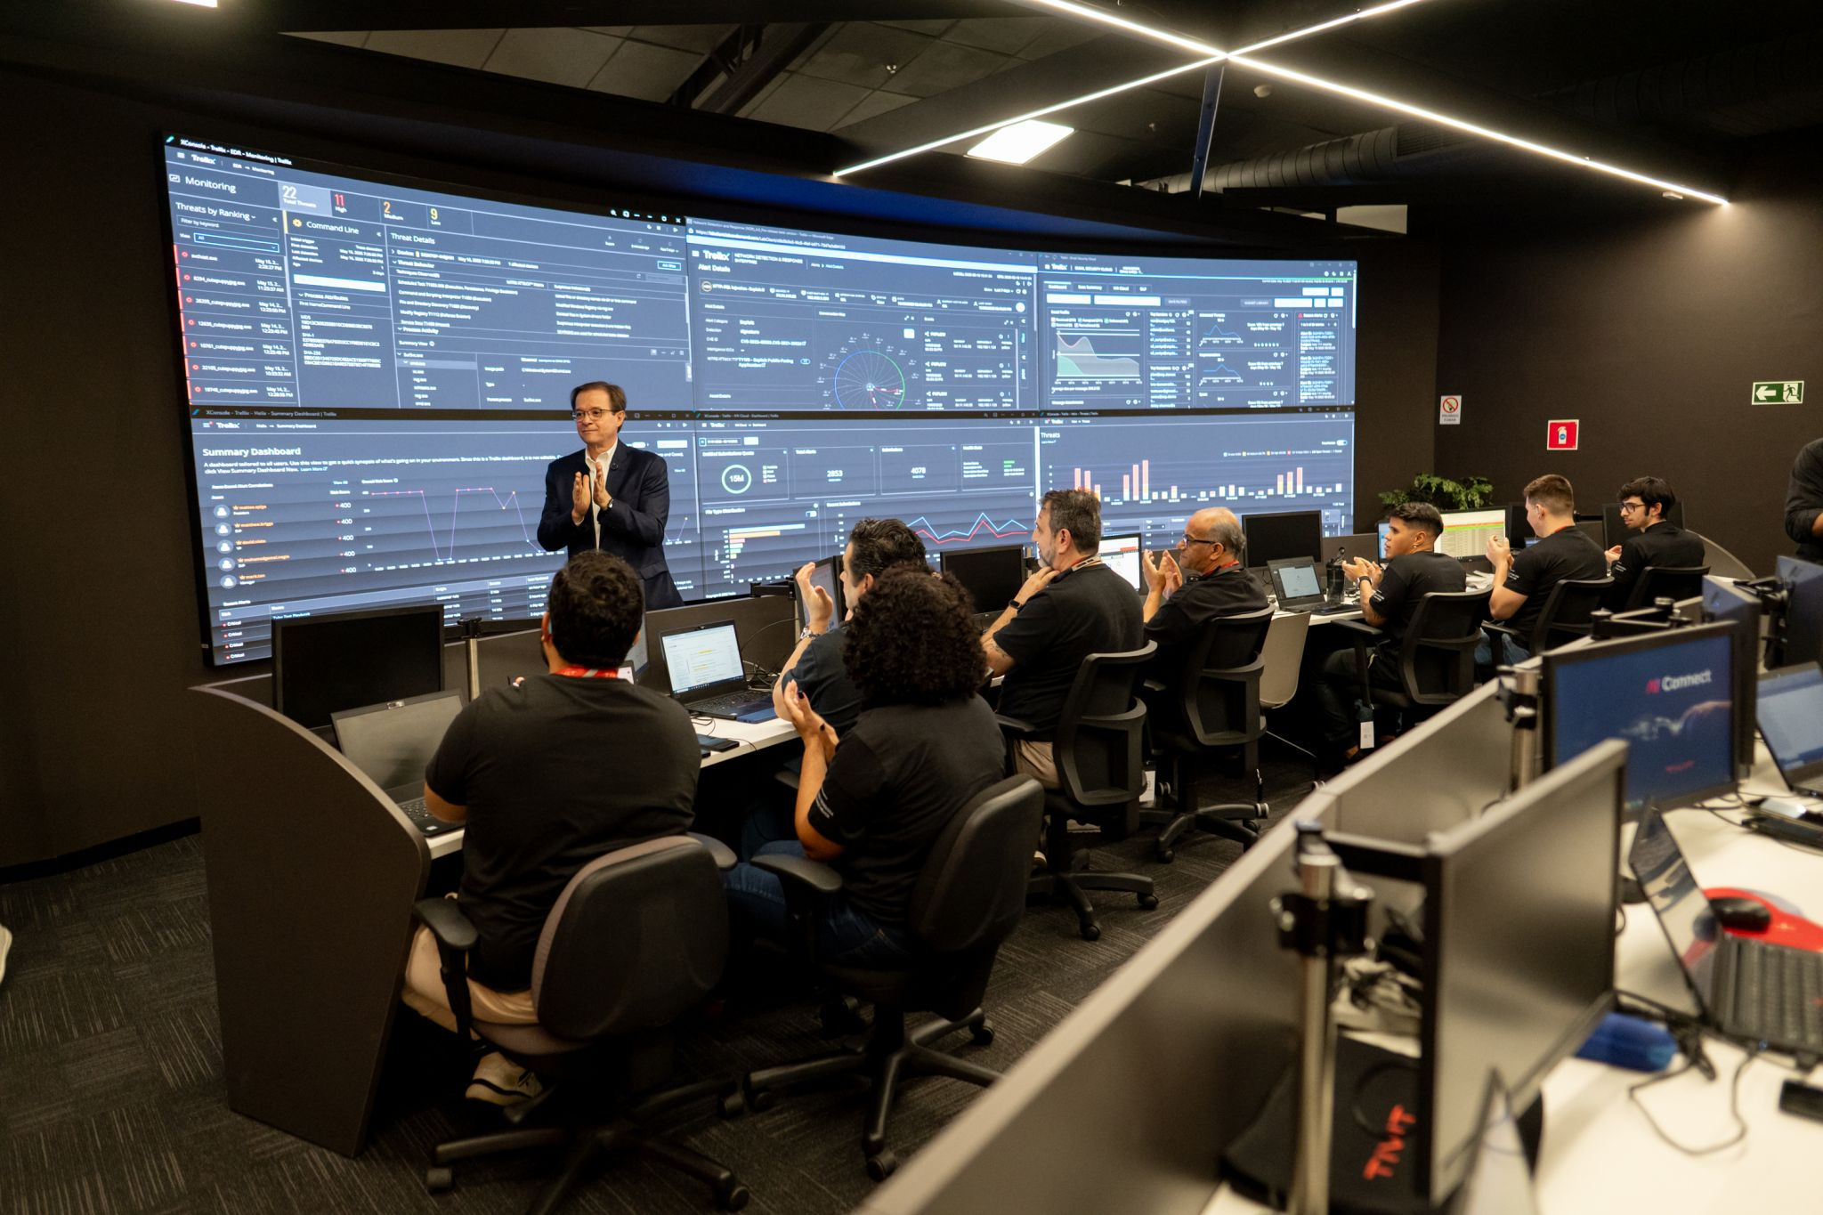


The new SOC expands our ability to
Security Operations Center
THE LARGEST INTEGRATED SOC IN LATIN AMERICA
Incident response
Forensic analysis
Risk Mananagement
80K
99%
24/7
Keypoints
+
Incidents respondes
in 2024
effective in handling tickets handled in 2024
SOC availability
Managed Security Services
In October, we will officially launch our SOC in Colombia

Slide 5




IoT & SMART
SYSTEM
CLOUD
DADOS & IA
Jornada de Transformación
DIGITAL
WORKPLACE
CYBER
ENTERPRISE
APPS
ESG
ECM & BI
DIGITAL
PLATAFORMAS
MANAGED &
PROFESSIONAL SERVICES

Slide 6







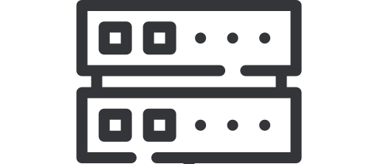
A través de soluciones que aceleran la innovación
Digital Workplace
ECM & BI
Monitoreo/ONE CLOUD
Plataformas
Ayudamos en la creación y gestión de entornos de trabajo colaborativos
Operamos en el procesamiento, almacenamiento y tráfico de información física o digital
Ayudamos a analizar y optimizar el rendimiento de aplicaciones, sistemas e infraestructura
Implementamos y gestionamos plataformas de vanguardia como ERPs, CRMs y aplicaciones de colaboración
Gestión de Crisis
Servicios transaccionales & Mainframe
IoT y Smart Systems
Sustentabilidad
Preparamos a la empresa para la prevención y respuesta ante imprevistos
Conectamos operaciones físicas y digitales a través de soluciones de automatización e internet de las cosas
Creamos estrategias sostenibles y eficientes en el uso de los recursos para impulsar el negocio
Aseguramos la disponibilidad de sistemas de misión crítica, transaccionales o mainframe

Slide 7











































¿Quién confía en TIVIT?

Slide 8
Almaviva

Slide 9
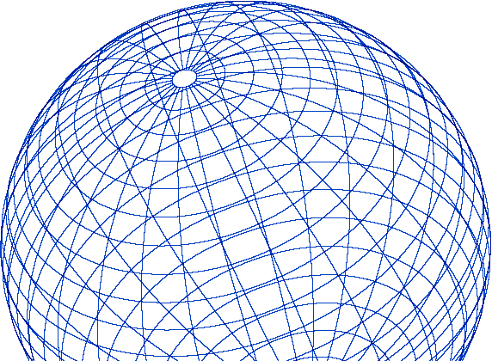


























Integración que impulsa el valor para los clientes, los empleados y mercado
Principales
Clientes
Portfolio
Combinación de experiencia en la nube, digital y transformación digital que amplía la oferta de soluciones de extremo a extremo
Presencia internacional
AlmaViva aporta solidez global y refuerza el desempeño de TIVIT en los mercados latinoamericanos.
Foco em el cliente
Mayor capacidad de entrega, personalización y escala, con un servicio aún más consultivo y estratégico.
+40
años de história através de la tecnologia
51 K
Colaboradores
21
países con expansión geográfica
2.1 B
de USD en Revenues
2024
79
oficinas aledor del mundo
+30
Premios de tecnología e innovación
2023

Slide 10

Overview of Almaviva
Cloud Computing & Consulting
Digital Change
Knowledge of Everything
System Integration
Cyber Security
PIS solutions & devices
Virtual & Augmented Reality
Real Time CGI
Smart-mobility
sensors
PRODUCTS & SERVICES OFFERING
Transportation
Public Administration
Finance
Healthcare, Tourism and Industry
Utilities and Energy
Smart Water Management
Others
BUSINESS
AREAS

Slide 11
Almawave

Slide 12



AIWave & Velvet
Almawave and its technology: LLM, Cognitive Services & AI Apps,
RAG, NLQuery and Voice Technologies
almawave.com

Slide 13

Overview of Almawave
AI Core Technologies
Cognitive Cloud PaaS and Vertical AI applications
Speech and text (>40 languages)
Conversational Platform
Enterprise Knowledge Graphs
and knowledge Management
Open Data Analytics
PRODUCTS & SERVICES OFFERING
Telco & Media
Automotive & Transportation
Government
Finance
Utilities and Energy
Smart Water Management
Healthcare and Tourism
Others
BUSINESS
AREAS

Slide 14





























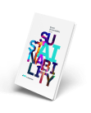
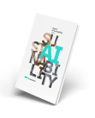
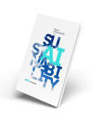










Our path in Artificial Intelligence
Italian Artificial Intelligence Company
2013
2010
450+
50+
430+
500+
CLIENTS
PEOPLE
LISTING
BORSA ITALIANA
PARTNERS
AI
PROJECTS
TRANSFORMER
DEEP LEARNING
2021
2019
2015
CERTIFICATIONS
2022
2023
ISO 9001 | SA 8000 | ISO/IEC 27001
ISO 30415 | UNI/PDR 125 | ISO 45001
ISO 14001 | ISO 37001 | ISO/IEC 20000-1
ISO 22301 | ISO/IEC 42001
2025
Cloud
Marketplace
30+
AI SOLUTIONS
GEN AI
SUSTAINABILITY REPORT
TECHNOLOGICAL PARTNERSHIP
AI APPS
AIWAVE COGNITIVE PLATFORM
AssoNEXT Best ESG Identity
Almawave is among the first companies globally
to have obtained the ISO/IEC 42001:2023 certification,
the first international management system standard for AI.
2020|2021|2022|2023
4 2 0 0 1

Slide 15














Almawave Group Companies
Technologies and vertical skills
A start-up from
Data Appeal: Florence Mabrian: Menorca (Spain)
Sister: Cascina (PI)
Obda Systems: Roma
AI, Data &
Location Intelligence
Advanced Solutions for Government, Energy & Utilities
Knowledge Graphs, Open Data, Data Quality & Integration
TOURISM FOCUS
Scalable proprietary indicators, platforms for analyses on the popularity of destinations and their points of interest, benchmarking also on a global scale, assessments on company and brand performance, market attractiveness, travel and tourism trends, including bookings and expenses.
ENERGY & UTILITIES FOCUS
Enterprise solutions for gas & water management through Digital Twins and decision support software that leverages geographic information systems (GIS), IoT technologies and workforce management modules.
KNOWLEDGE MANAGEMENT FOCUS
Solutions and technologies supporting
the Ontology-Based Data Management approach.
OBDA offers technologies and consultancy services aimed to simplify the semantic exploration and retrieval of complex dataset from distributed DBMS, so as to overcome information “silos” and create shared knowledge.
OBDA contributes to the National Data Catalog project, aimed to build a full interoperable data network among the EU Government Entities.
RETAIL FOCUS
AI-enabled solutions capable of transforming complex data into practical strategies, thus helping businesses across all sectors reach their goals, optimise resources, obtain precise and reliable answers, and foster sustainability.
GOVERNMENT & MUNICIPALITIES FOCUS
End-to-end software solutions aimed to manage the dissemination, exchange and analysis of statistical data, by means of international standard-based data modeling and AI algorithms.

Slide 16
Almawave’s approach: Composite, Generative, Multi-Agentic RAG Architecture
A continuously evolving integrated ecosystem
Retrieval Augmented Generation (RAG)
Conversational Agents
Simplification of Document Analysis (potential gaps or inconsistencies in contract drafts, bid responses and more)
Simplification of specialized text (Senado Italiano)
Pseudoanonimization of personal data (judiciary sentences)
Natural Query Languaje (NLQ)
Tickets emitidos por ruta
Times series for energy comsumption
Speech to Text, Text to Speech & Machine Translations

Slide 17
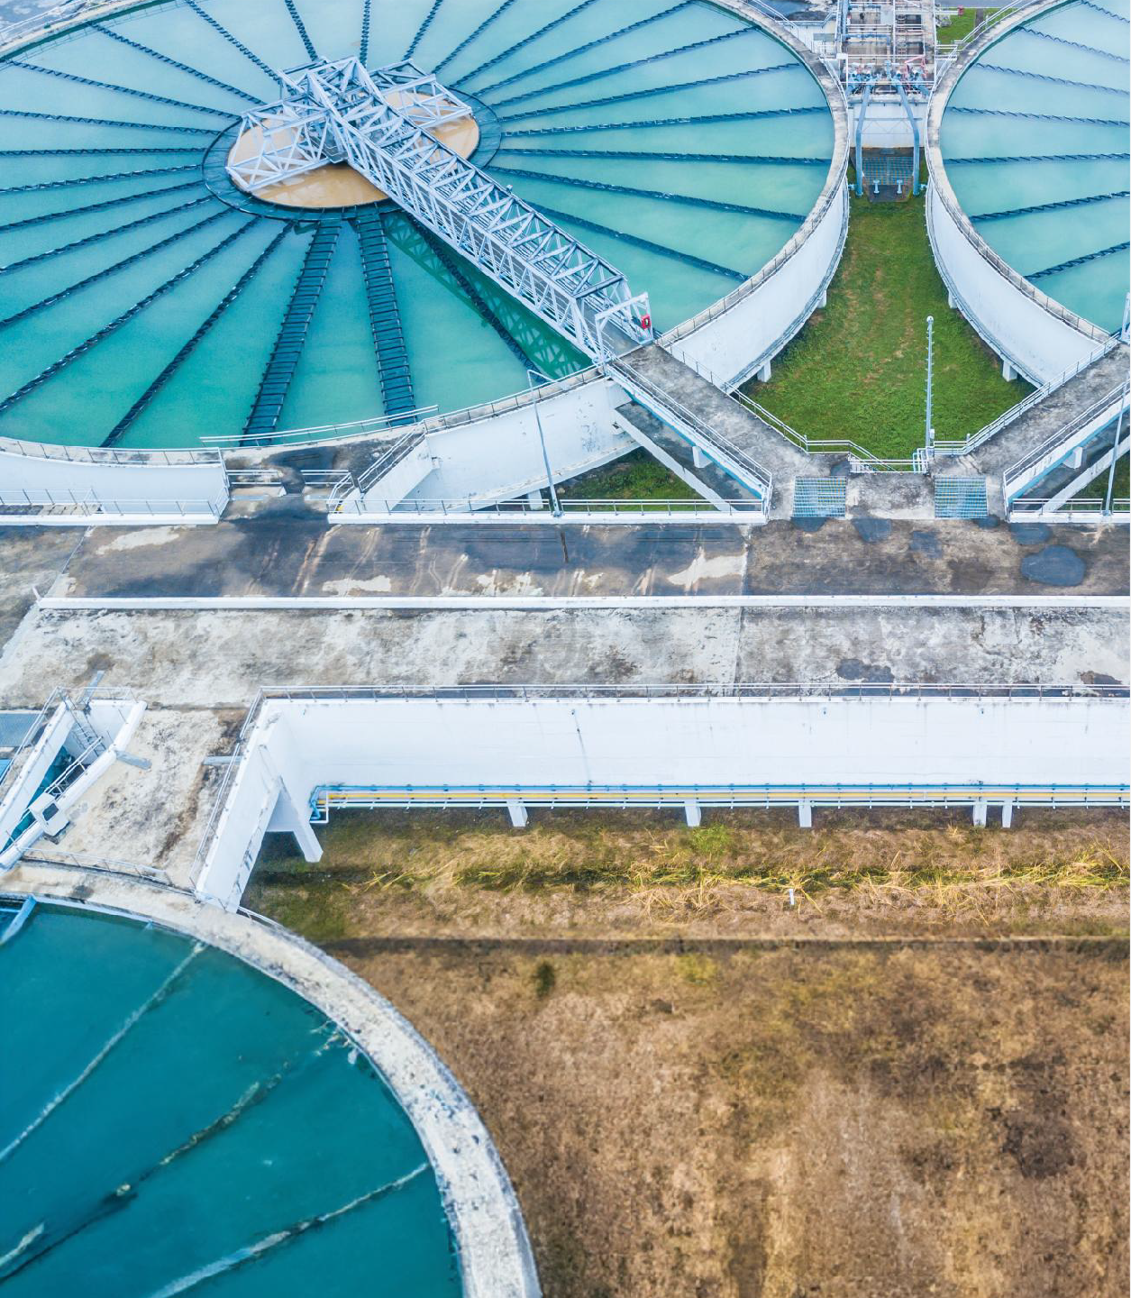


Smart Water Management System
ASSET MANAGEMENT & OPERATIONS
A software system for decision support in water networks.
By integrating digital representations of the network, data from IoT sensors, workforce management systems and analytics and reporting tools, it creates a true «digital twin» for continuous monitoring, preventive maintenance and simulations.
POSSIBLE USE CASES
Early warnings on leaks, faults and anomalies |  | Notes on network anomalies and their classification
Immediate and precise reports to the authorities |  | Accurate planning of interventions and revisions
KEY HIGHLIGHTS
GIS technologies for maps, geostatistical indicators and thematic layers
Water modelling and network diagram processing
Advanced asset management with interactive cards and augmented reality
Workforce management for work planning and information from the field
Voice commands and "smart" queries on consumption, flow rates, …
Physical-mathematical models for what-if analysis and scenario forecasts
DATA & GIS

Slide 18
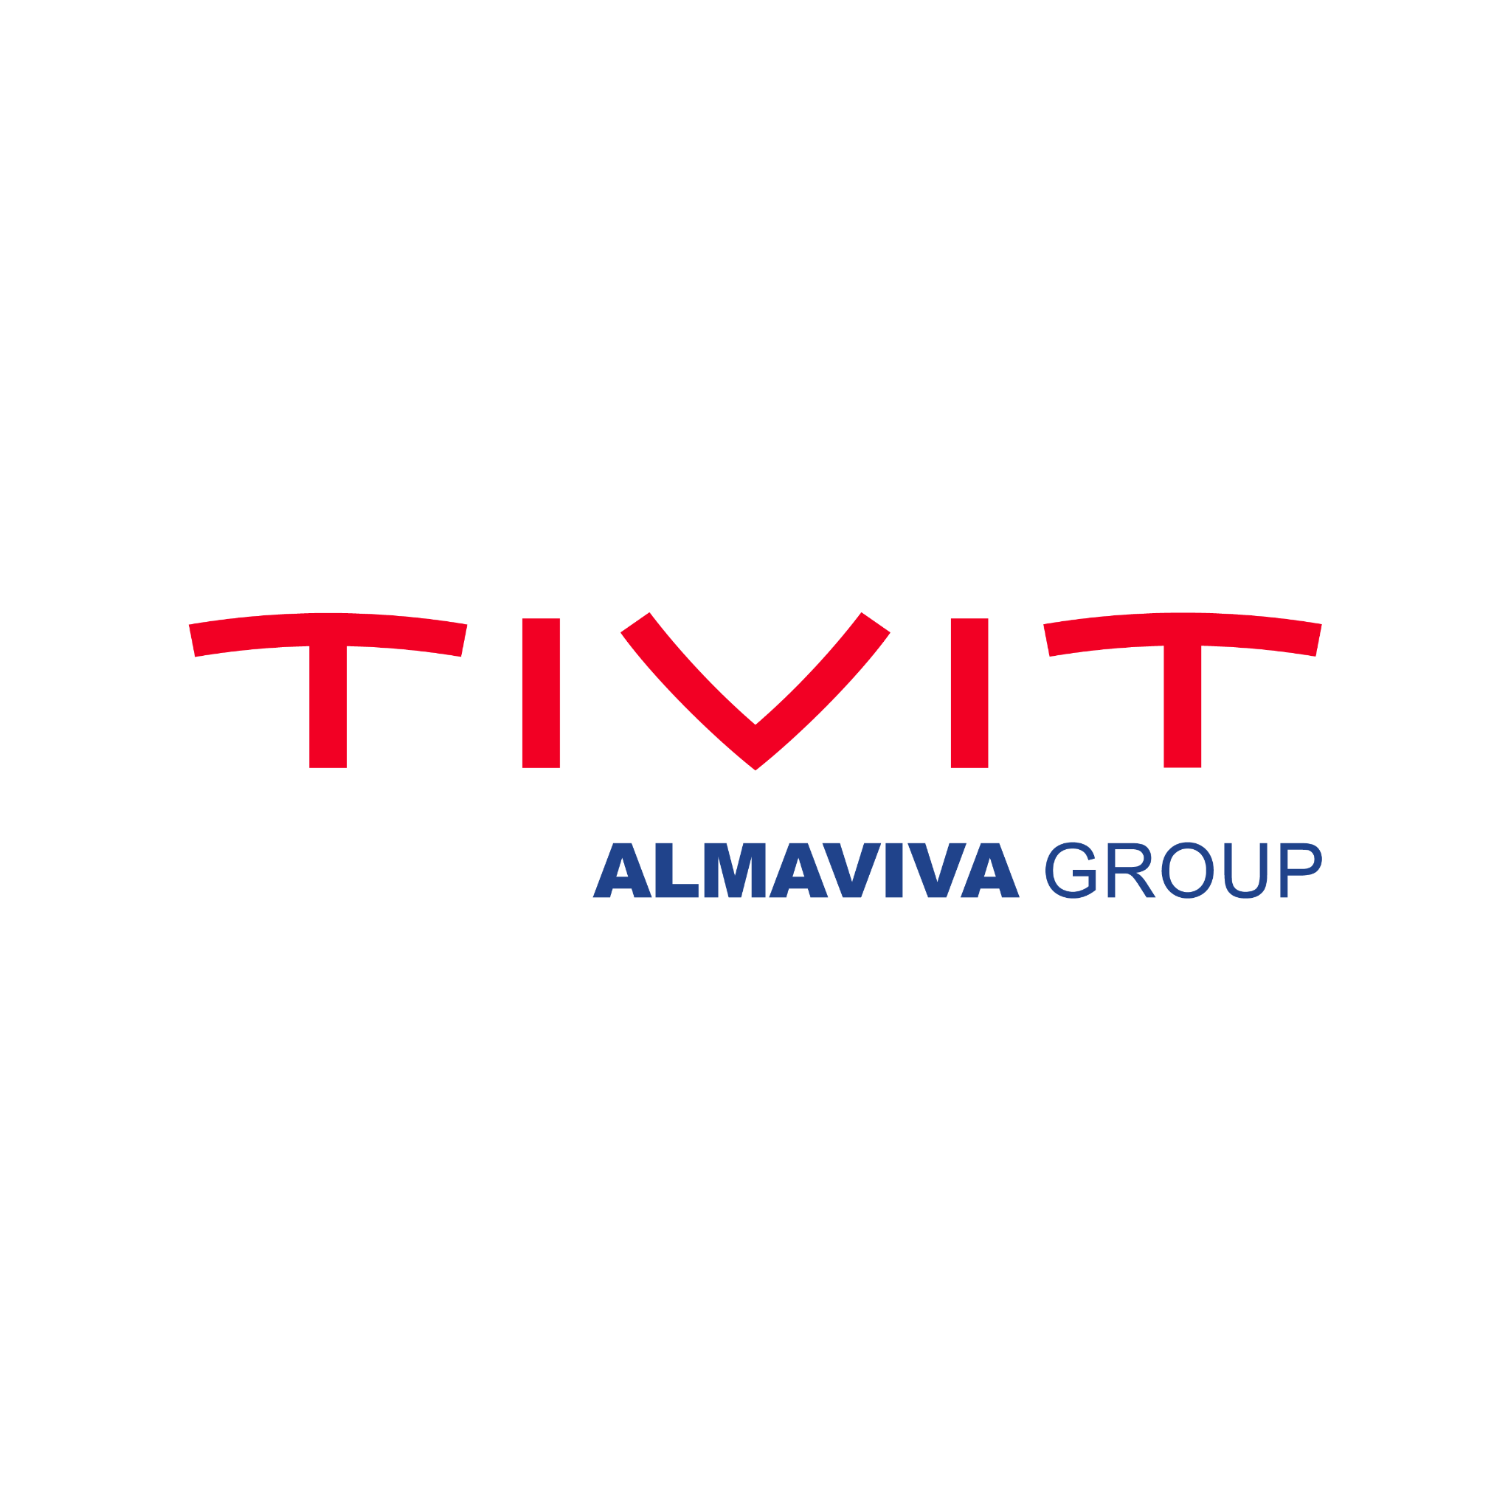




Conectando tecnología para un mundo mejor
/tivit_oficial​
/tivitoficial​
/company/tivit​
/tivitoficial​

